Slide 1
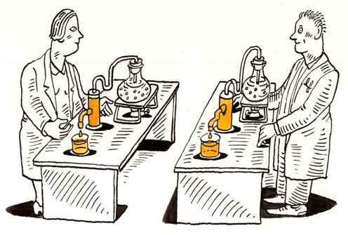
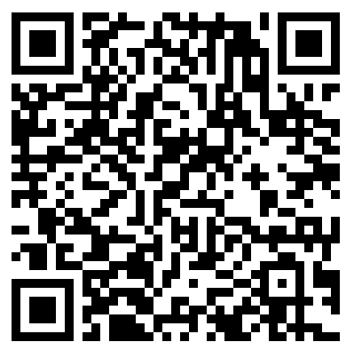
Introduction to Reproducible Science: Day 1
Nelson Roque, PhD
Scan for
Slides & Code available on GitHub
Notes:
Image: https://www.displayr.com/what-is-reproducible-research/

Slide 2
Background
Over the last decade I've engaged in professional development and research opportunities to become proficient across topics including data wrangling and modeling of text, image, video, and eye-tracking data, as well as more recently, sensor data.
I look forward to training the next generation of scientists on code-based methods to enhance reproducibility and usability of their research results.

Slide 3
About this Workshop
3 days: July 6, 8, 11, 11am to 2pm
In-person, room 301Q, but also recorded
All slides, code, and recordings will be made available at the website listed below, as well as Github
Code & Slides
https://github.com/nelsonroque/contextlab_reproduciblescience_workshops
Textbook
https://nelsonroque.github.io/contextlab_introdatascience_webcourse/

Slide 4

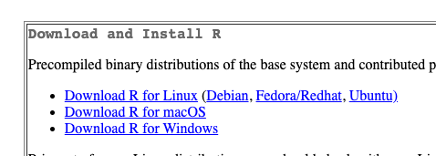
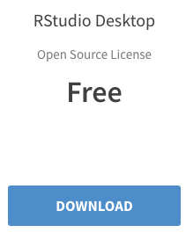

Software Required for Workshop
R - https://cran.r-project.org/
RStudio - https://www.rstudio.com/products/rstudio/download/

Slide 5
Workshop Learning Objectives
Describe various principles, tools and techniques supportive of open and reproducible science.
List and describe the FAIR Principles (https://www.go-fair.org/fair-principles)
Develop a code-only pipeline to allow reproducibility of data prep and analyses.
Learn about data wrangling principles (e.g., tidy data)
Import, pre-process & visualize data using R
Develop a long-term learning plan for practicing reproducible science tools and techniques.
Share recommended readings, activities for continued learning

Slide 6
Agenda: Day 1
What is Reproducible Science?
Reproducible & FAIR Data Workflows
Tools Supporting Reproducible Science
Overview of available tools
Skill 1: Using Endnote for Reference Management
Skill 2: Using Git (and Github) for code management and collaboration
Orientation to R, RStudio, RMarkdown
Skill 3: R syntax primer
Data Science: Latest trends
Long-term Learning Recommendations
Notes:
How version control works
Show diagrams of branches and merges, pull requests

Slide 7
Agenda: Day 2
Data wrangling and visualization of Big Data
Skill 1: Data wrangling the Google Mobility dataset
Reproducible survey research
Qualtrics survey design tips
Skill 2: Data wrangling Qualtrics data
Working with JSON data
Skill 3: cleaning and visualizing keystroke JSON data

Slide 8
Agenda: Day 3
Text mining
Skill 1: word and bigram frequency analysis
Skill 2: generating wordclouds
Skill 3: sentiment analysis
Interacting with APIs and JSON data
Skill 4: querying API for results and data aggregation
Closing Discussion & Q/A

Slide 9
What is Reproducible Science?

Slide 10

Icebreaker: Introductions
Name, lab affiliation
What does reproducible science mean to you?
Which tools have you previously used?
Which tools are you most excited to learn?

Slide 11
Background
A reproducibility crisis (Ioannidis, 2005; Open Science Collaboration, 2015) has emerged as a threat to the scientific enterprise.
Ioannidis, John P A. 2005. “Why Most Published Research Findings Are False.” PLoS Medicine 2 (8): e124. doi:10.1371/journal.pmed.0020124.
Munafò, M. R., Nosek, B. A., Bishop, D. V., Button, K. S., Chambers, C. D., Percie du Sert, N., ... & Ioannidis, J. (2017). A manifesto for reproducible science. Nature human behaviour, 1(1), 1-9.
Open Science Collaboration. 2015. “Estimating the Reproducibility of Psychological Science.” Science 349 (6251): aac4716–aac4716. doi:10.1126/science.aac4716.

Slide 12
What is reproducible science?
Making entire scientific process transparent (as allowable; often required by law, grants).
Sharing experiment, raw data, and analysis code
Detailed methods sections
Sharing stimulus sets
Being able to walk through a data analysis start (load raw data) to finish (manuscript analyses) in code
Following FAIR Principles
Pre-registering hypotheses and analysis plans (e.g., on OSF)
Notes:
More on this: https://www.displayr.com/what-is-reproducible-research/

Slide 13
Benefits of reproducible research
increased likelihood that the research will be correct
reproducibility makes it easier to check the research
it is easier to reproduce the research independently
easier to extend the research
reusable code and instruction resulting in increased efficiencies
https://www.displayr.com/what-is-reproducible-research

Slide 14
Reproducible versus replicable
Reproducible: when the exact results can be reproduced if given access to the original data, software, or code
Replicable: research results can be reproduced by independent researchers using different methods.

Slide 15

Improving Usability of Reproducible Research
Hundreds of reporting guidelines exist to enhance usability of research

Slide 16
Reproducible & FAIR Data Workflows

Slide 17
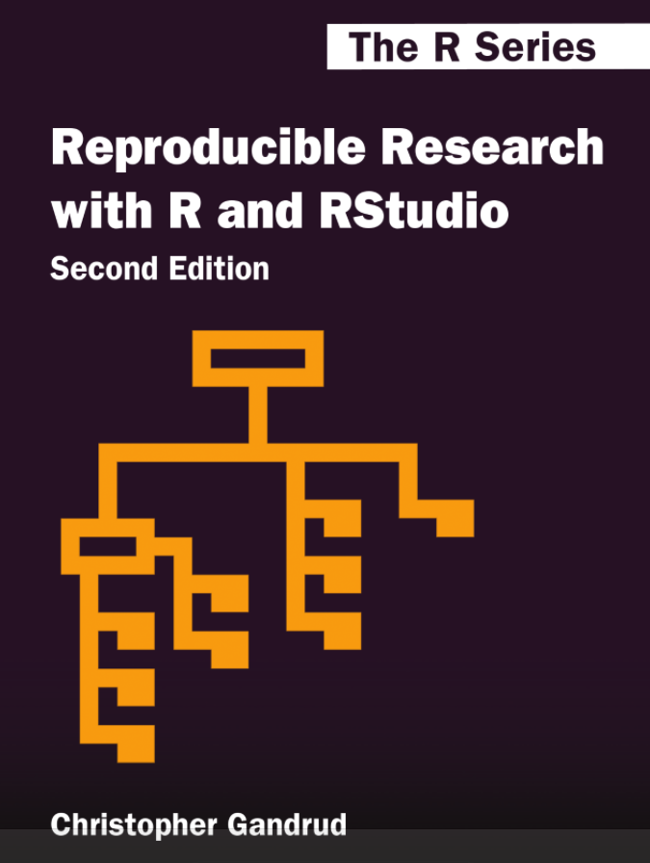
Reproducible Workflows
Documented, code-based approach to pre-processing and analytics
R (RMarkdown), Python (Jupyter notebooks)
File versioning with clear changelogs
Git and Github
https://monashdatafluency.github.io/r-rep-res/

Slide 18

Typical Data Science Workflow
Data collection
Source: R for Data Science
Notes:
https://vita.had.co.nz/papers/tidy-data.pdf

Slide 19
What is tidy data?
Every column is a variable.
Every row is an observation.
Every cell is a single value.
participant | condition | avg_response_time | perc_accuracy
9991 | control | 506 | 90
9992 | active | 516 | 96
9993 | control | 526 | 99
Source: R for Data Science
Notes:
https://vita.had.co.nz/papers/tidy-data.pdf

Slide 20
Uncleaned Data Problems
In a perfect data-generating system, data are already tidy
In practice, we must first determine
data structure issues, including:
Column headers are values, not variable names.
Multiple variables are stored in one column.
Variables are stored in both rows and columns.
Multiple types of observational units are stored in the same table.
A single observational unit is stored in multiple tables.
Data quality issues
Values out of range
Improperly/inconsistently coded response options
Inconsistent records counts

Slide 21
FAIR Principles
F
Findable: "The first step in (re)using data is to find them. Metadata and data should be easy to find for both humans and computers. Machine-readable metadata are essential for automatic discovery of datasets and services”
Accessible: "Once the user finds the required data, she/he/they need to know how they can be accessed, possibly including authentication and authorisation.”
Interoperable: "The data usually need to be integrated with other data. In addition, the data need to interoperate with applications or workflows for analysis, storage, and processing.”
Reusable: "The ultimate goal of FAIR is to optimise the reuse of data. To achieve this, metadata and data should be well-described so that they can be replicated and/or combined in different settings."
A
I
R
https://www.go-fair.org/fair-principles
Notes:
Learn more about the FAIR Principles
https://www.go-fair.org/fair-principles
https://www.go-fair.org/wp-content/uploads/2022/01/FAIRPrinciples_overview.pdf

Slide 22
Tools Supporting Reproducible Science

Slide 23
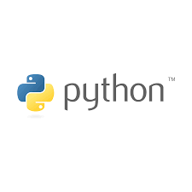










Tools Supporting Reproducible Science
R
Latex, Markdown
Python, Anaconda
Github, Github Pages: https://pages.github.com
Docker, VMs
Infrastructure as Code (IaC; e.g., AWS CDK)
IDEs (e.g., Visual Studio Code)
Open Science Framework
Documentation software: Docusaurus, https://docusaurus.io
Code-based experiment creation software: Opensesame, Psychopy, jsPsych

Slide 24
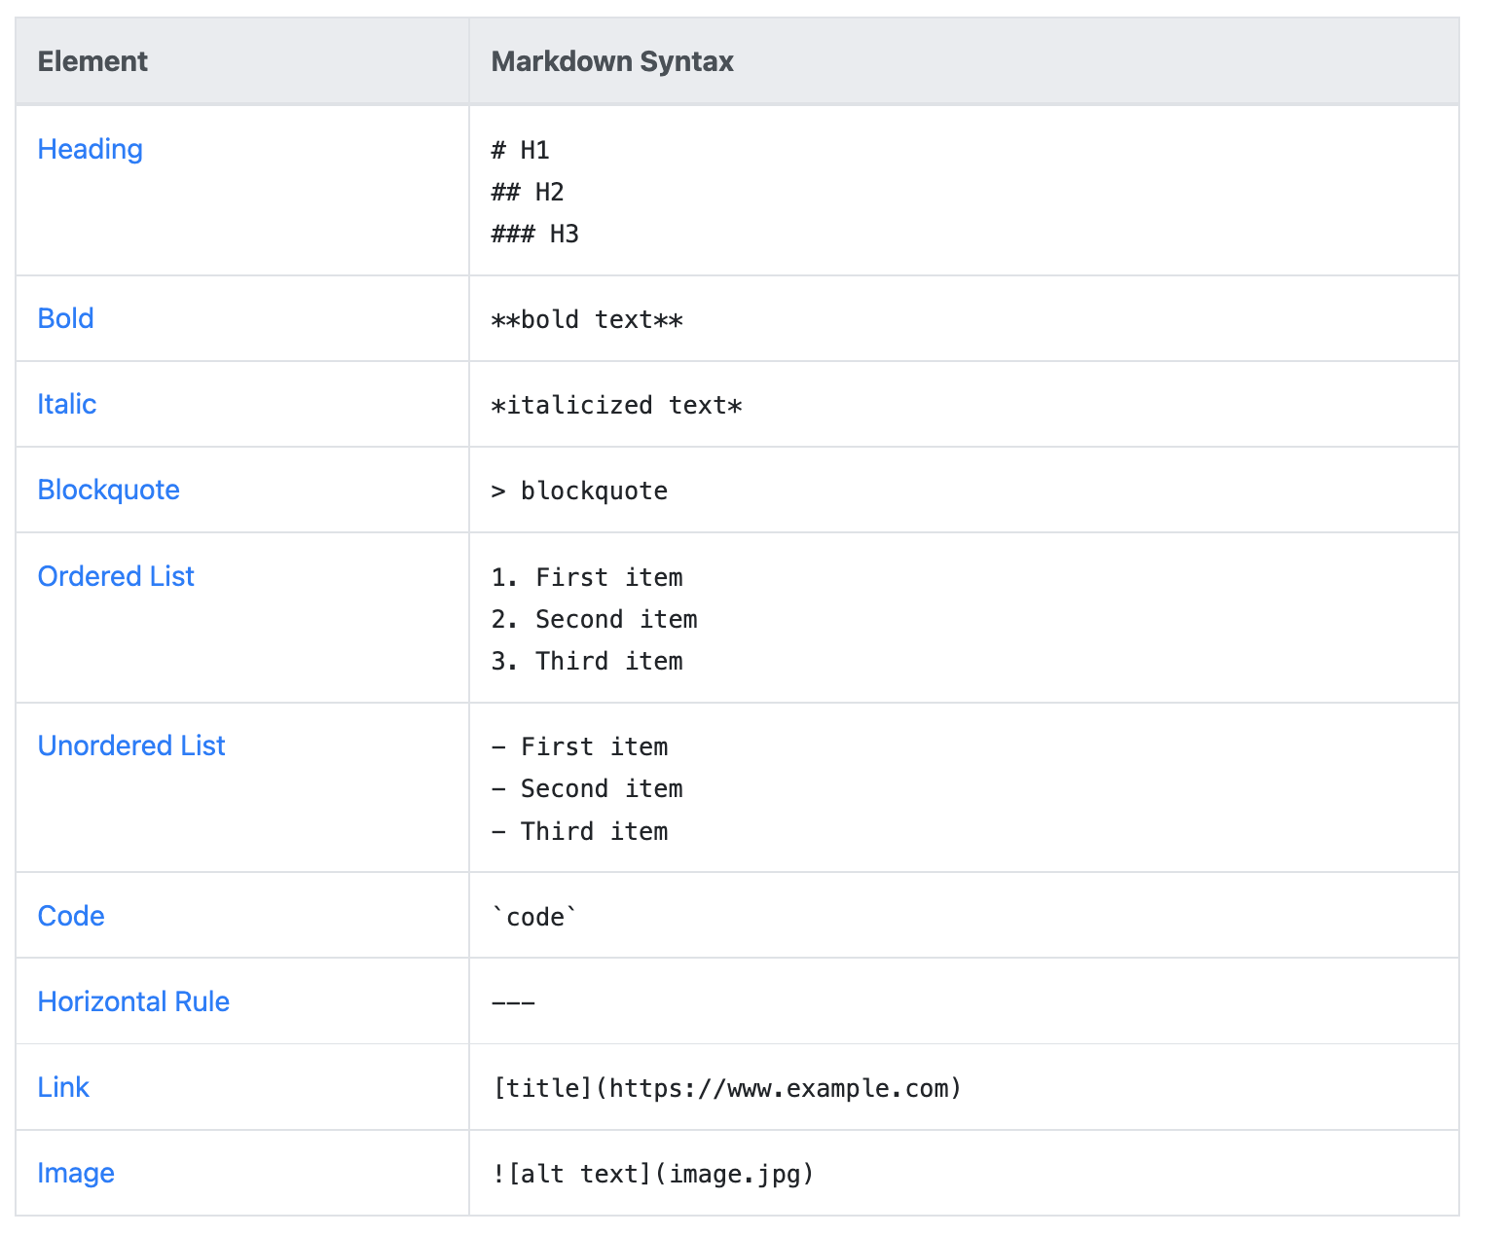
Markdown
Lightweight markup used to add formatting elements to plaintext documents.
Created by John Gruber in 2004, Markdown is now one of the world’s most popular markup languages.
Using Markdown is different than using a WYSIWYG editor.
In Word, you click buttons in GUI to apply formatting
In Markdown, you add syntax to text to apply formatting
https://www.markdownguide.org/getting-started/

Slide 25
What is Git?
A version control system to manage code; edits, branching, and collaboration.
Git providers
Open source Git: https://git-scm.com/
Github - https://desktop.github.com
Get Github Cheatsheets: https://training.github.com/downloads/github-git-cheat-sheet/
Gitlab

Slide 26
Git These Concepts
Repository: a logical unit of storage for maintaining code/other assets. Can contain many folders, files.
.gitignore: a file (with dot prefix) to specify what files should NOT be pushed to Github
.gitkeep: a file (with dot prefix) to specify that a folder should be kept if blank as part of the project structure. This is helpful when creating templates.
commit: create a record/snapshot of all files (or specific files) at a moment in time. You may tag collaborators, add a title and notes.
push: 'storing' the result of prior commits
pull: 'extracting' the result of prior commits
diff: difference (line-specific) between two commits. Helpful when trying to remember when and where code edits where made.

Slide 27
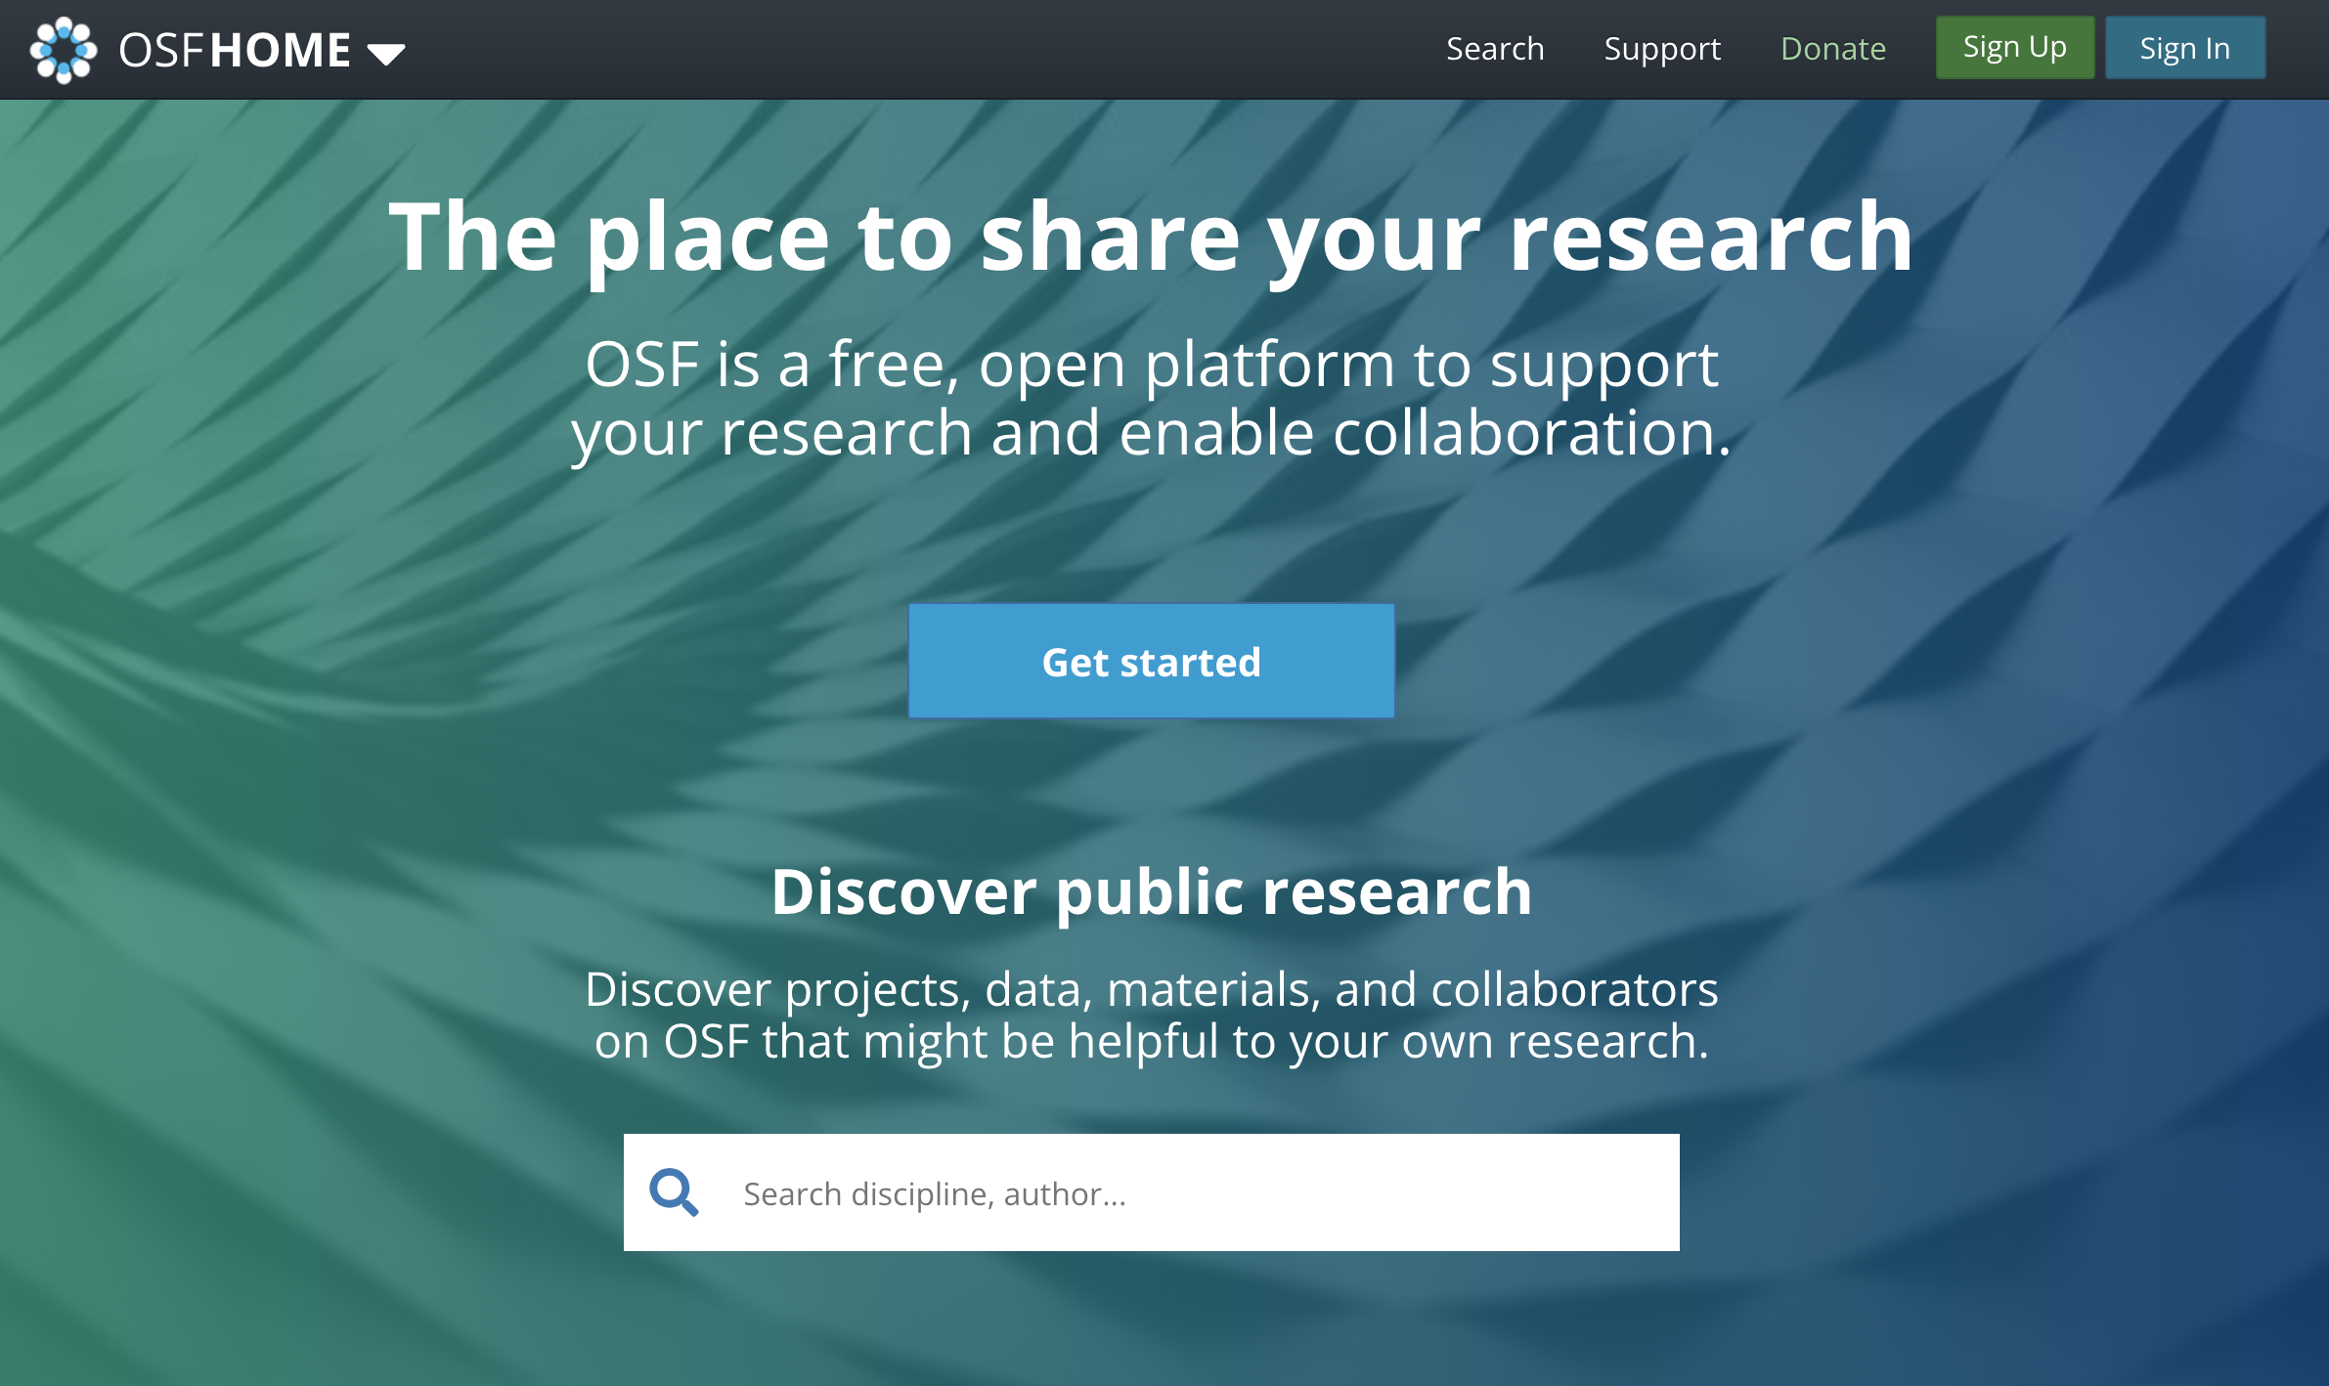
OSF
Preregister study design, hypotheses, analysis plans and scripts
Post-hoc curate documentation for your study across various components (IRB, surveys, stimuli, datasets, codebooks)

Slide 28

PsyArXiv
Publish pre-prints of your paper
Supports immediate sharing of research
https://psyarxiv.com

Slide 29
Let’s jump into Github
Download here:
https://desktop.github.com
Notes:
https://github.com/nelsonroque/contextlab_github_101

Slide 30
Endnote
What is Endnote?
a citation manager (like Zotero, Mendeley)
Guide from the UCF library with installation links: https://guides.ucf.edu/citations-endnote
Why Endnote?
no need for manual tracking (deleting, updating) of references
change citation format at click of a button
capture PDFs for any citations at click of a button
Downloads:
[Mac](http://ezproxy.library.ucf.edu/loggedin/EndNote20SiteInstaller.zip)
[Windows](http://ezproxy.library.ucf.edu/loggedin/EndNote20.zip)

Slide 31
Let’s jump into Endnote
Download here:
https://guides.ucf.edu/citations-endnote

Slide 32
Orientation to R, RStudio, RMarkdown

Slide 33
What is R? RStudio?
What is R?
Statistical programming language (released ~1993). Similar to `S` (released ~1976)
Download R: https://cran.r-project.org
What is RStudio?
Integrated development environment (IDE) for R; view data objects, plots, and file directory all in one place.
Download Rstudio: https://www.rstudio.com/products/rstudio/download

Slide 34
What are R packages?
Libraries of code to accomplish specific functions
e.g., data viz, machine learning, data wrangling, compute effect sizes
Think of CRAN as an equivalent to iOS App Store, or Google Play Store
CRAN is where you download published R packages (directly from R, RStudio)
A developer can also make packages available directly in source code, or via tools like Github, for example:
install.packages("devtools")
devtools::install_github("nelsonroque/ruf")

Slide 35
What is RMarkdown?
Reproducible notebook (akin to Jupyter Notebooks in Python) where you can write a narrative using Markdown syntax and embed code/plots throughout.
Based on Markdown syntax: https://www.markdownguide.org/basic-syntax/
With R Markdown, you can generate HTML, PDF, MS Word documents, PowerPoint presentations, and books!
Learn More: http://rmarkdown.rstudio.com

Slide 36
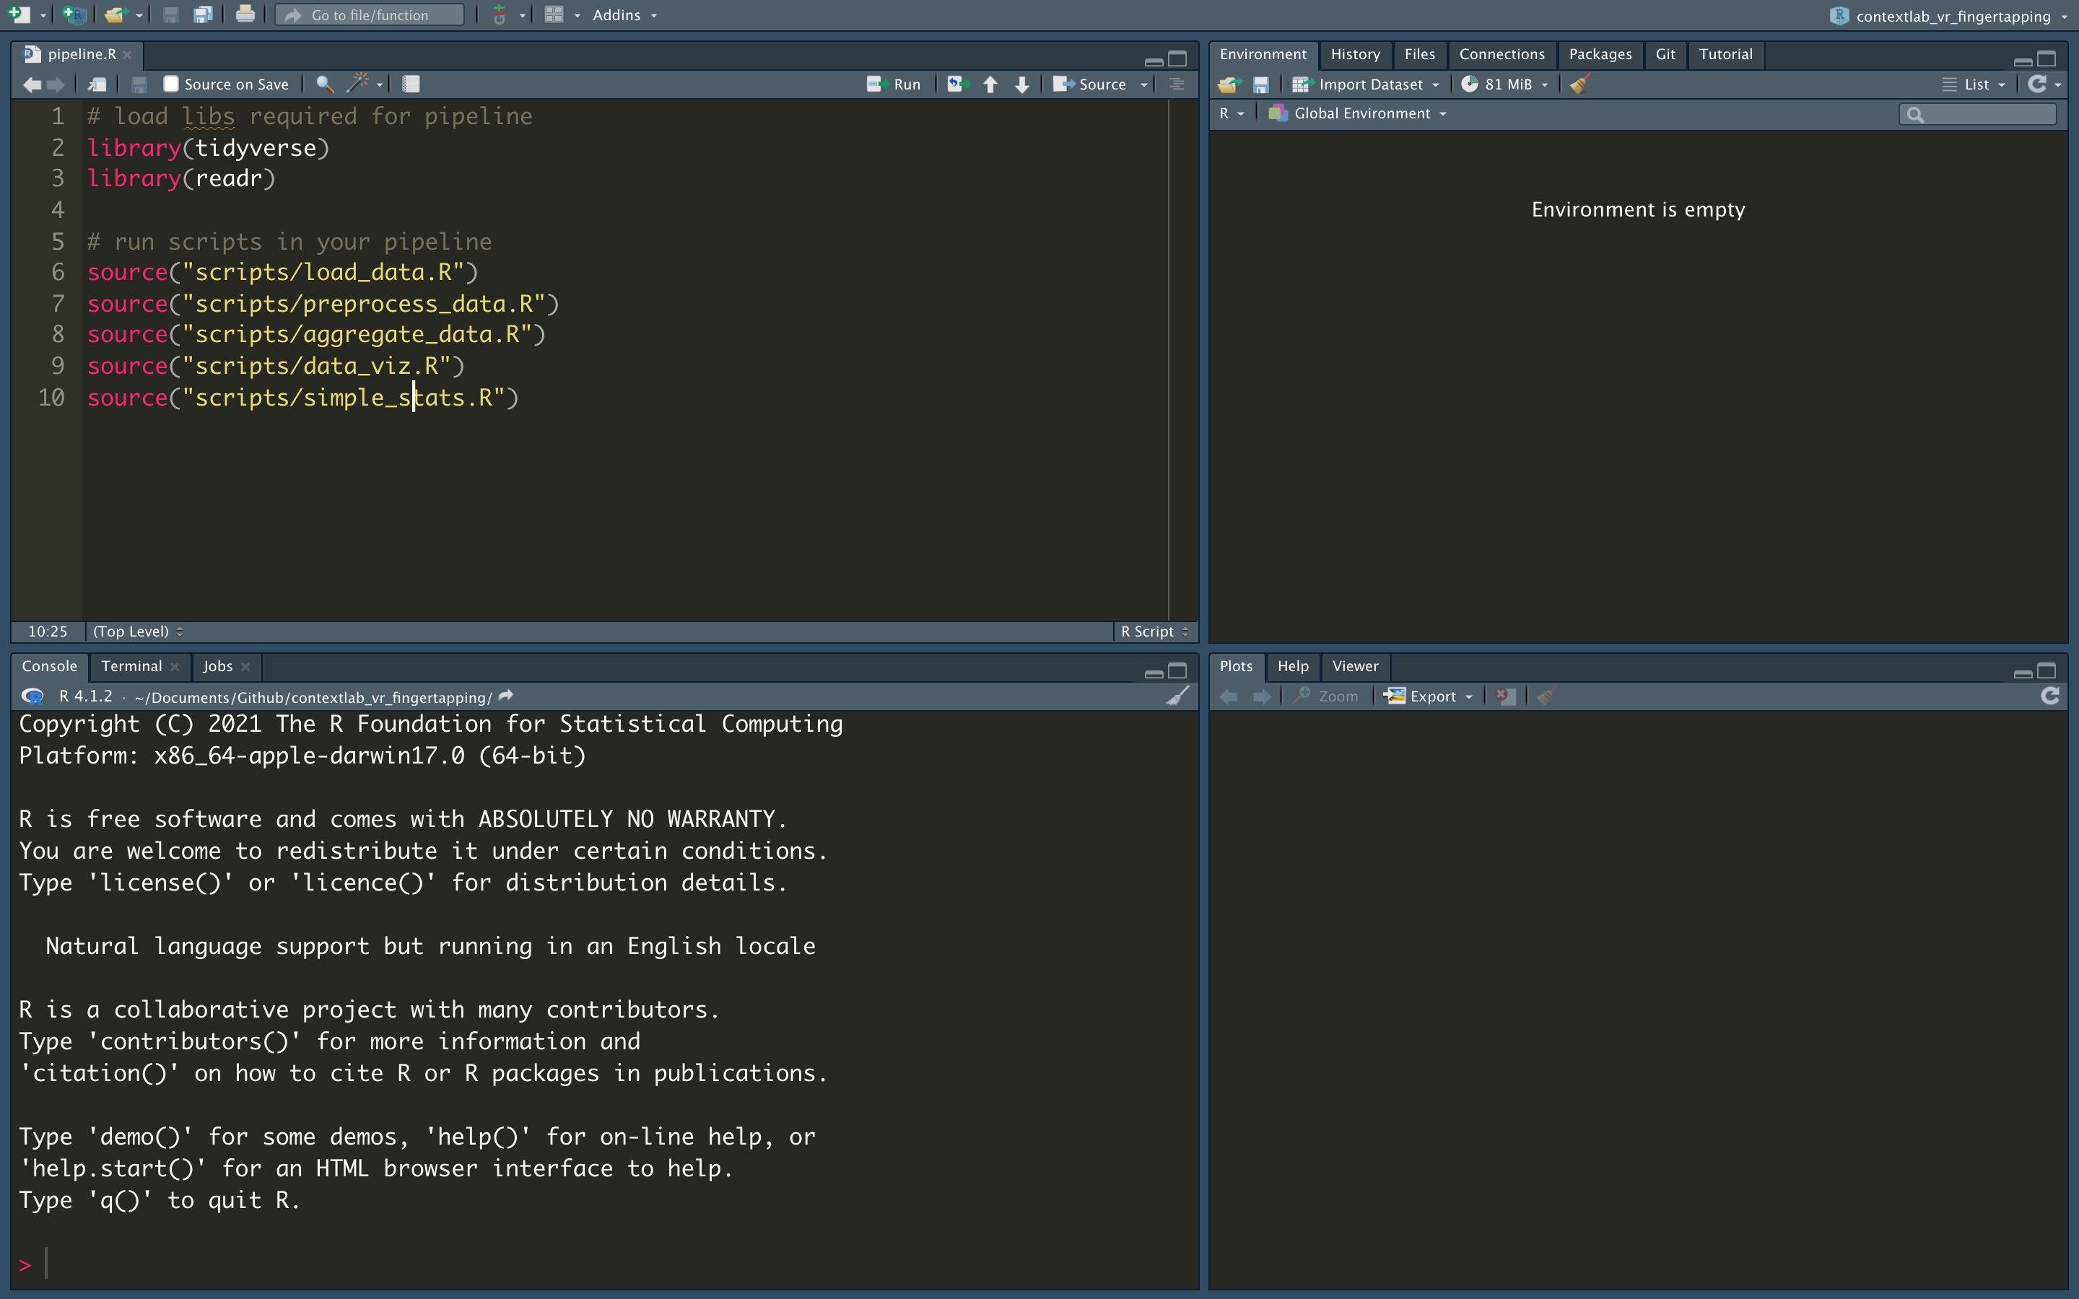
Scripts

Slide 37
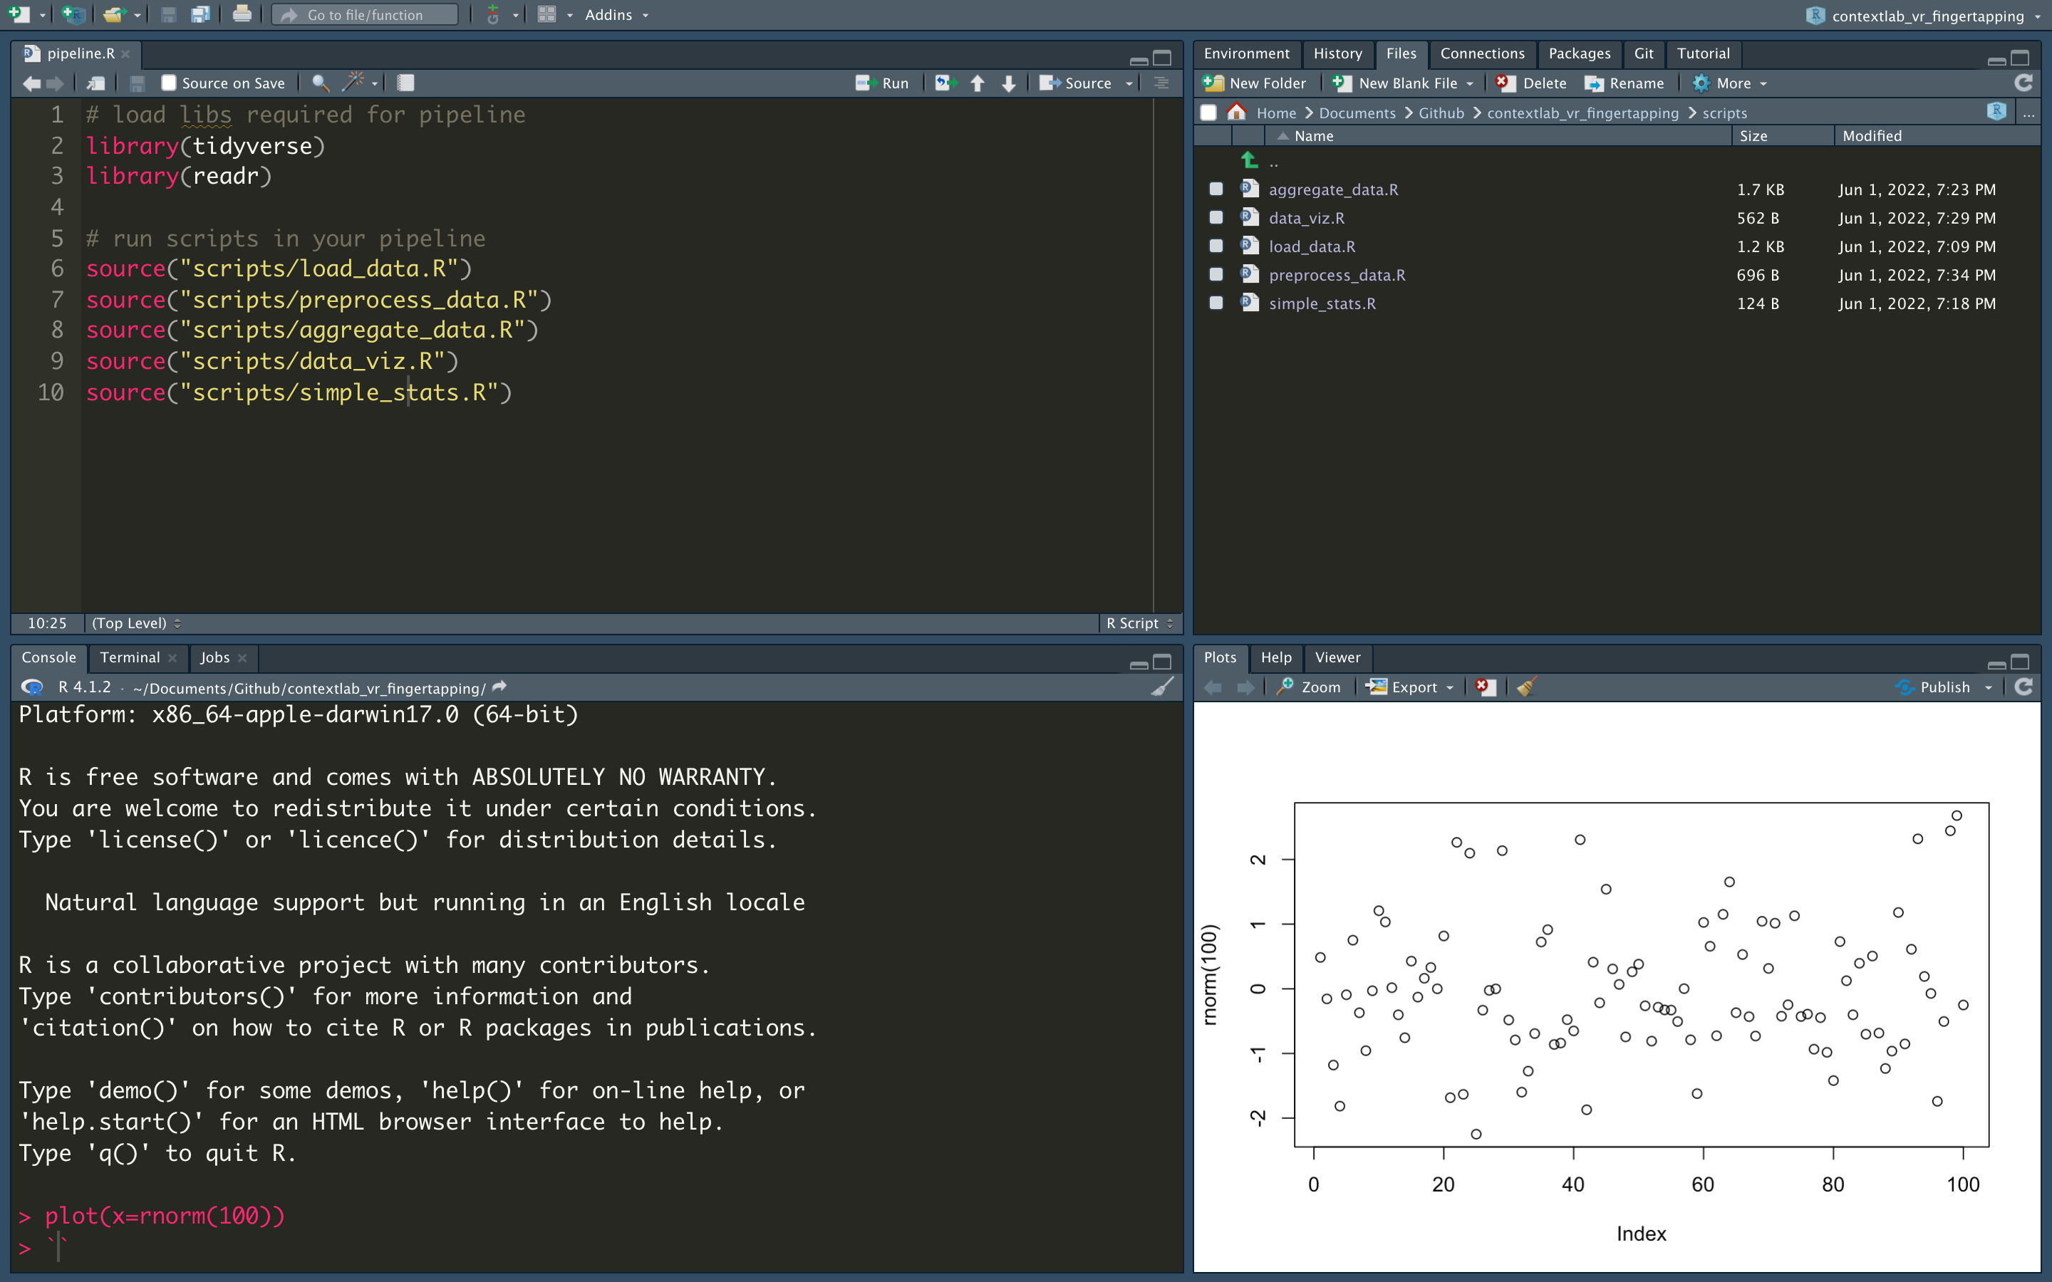
Files

Slide 38
Console: run one-off commands

Slide 39
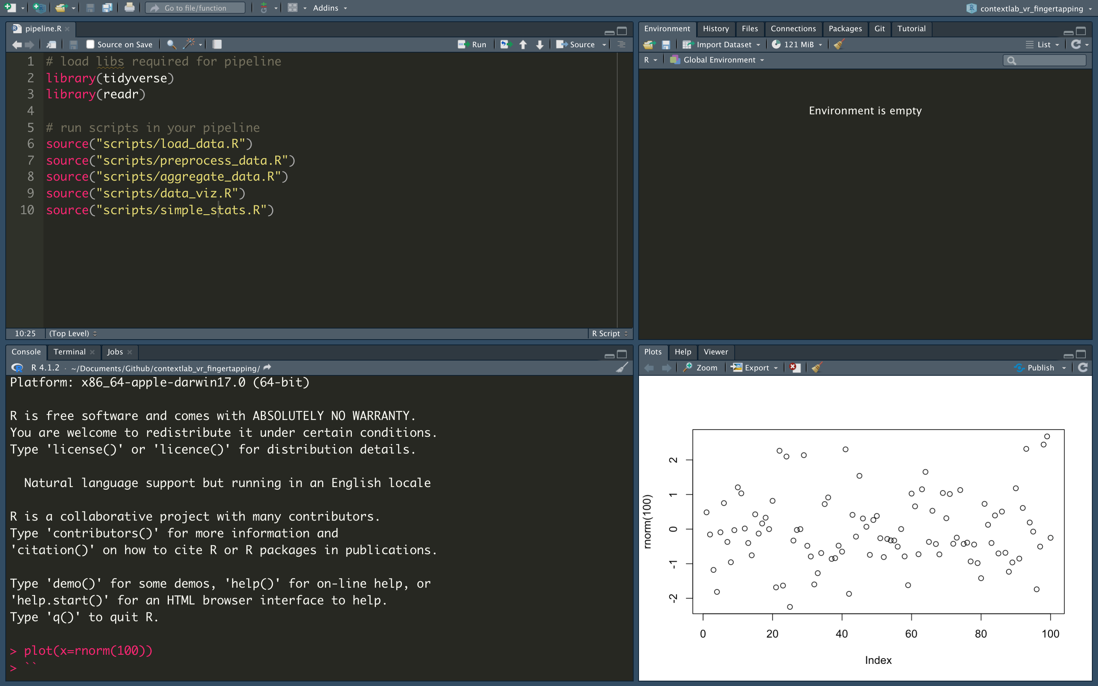
Plots

Slide 40
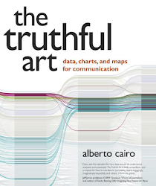
PSA: Five Qualities of Great Visualizations
Truthful: transparency in decision making and reporting
Functional: understandable, uncluttered
Beautiful: plots can be art too
https://playingthearchive.com
Insightful: reveal trends or relationships
Enlightening: integration of 1-4 executed succesfully

Slide 41
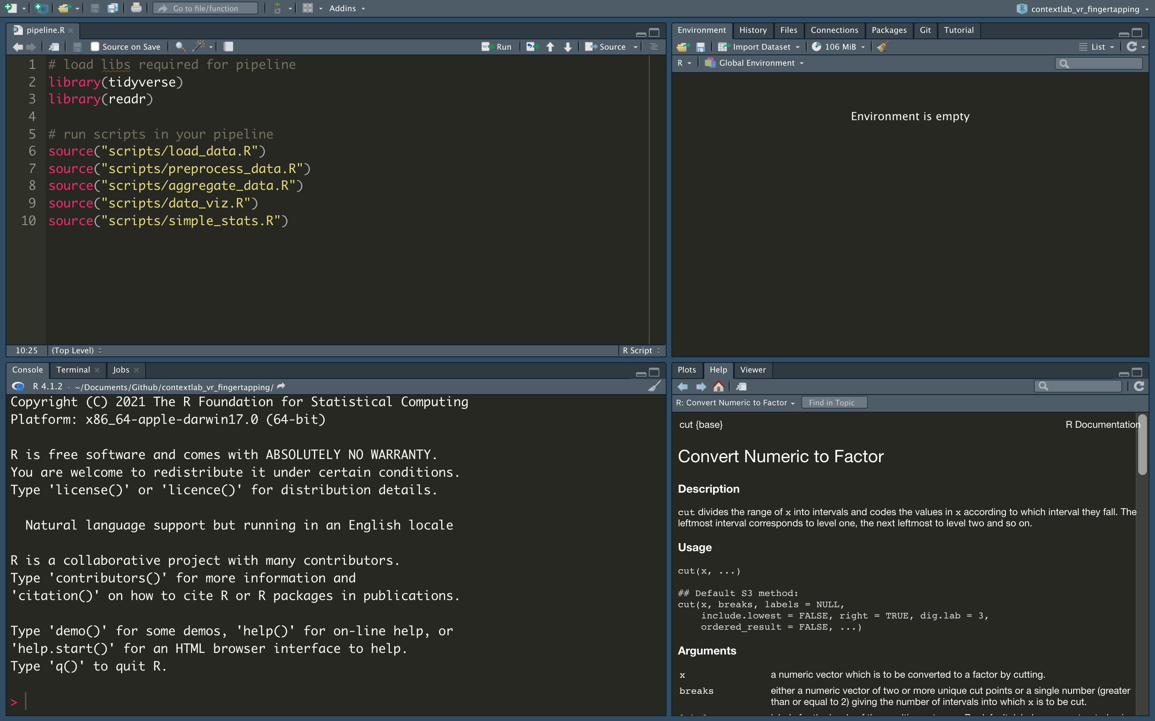
Help

Slide 42
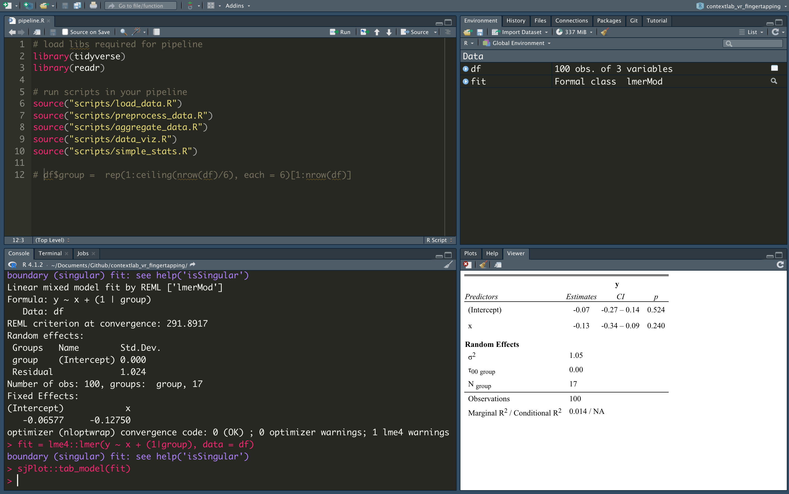
Viewer

Slide 43
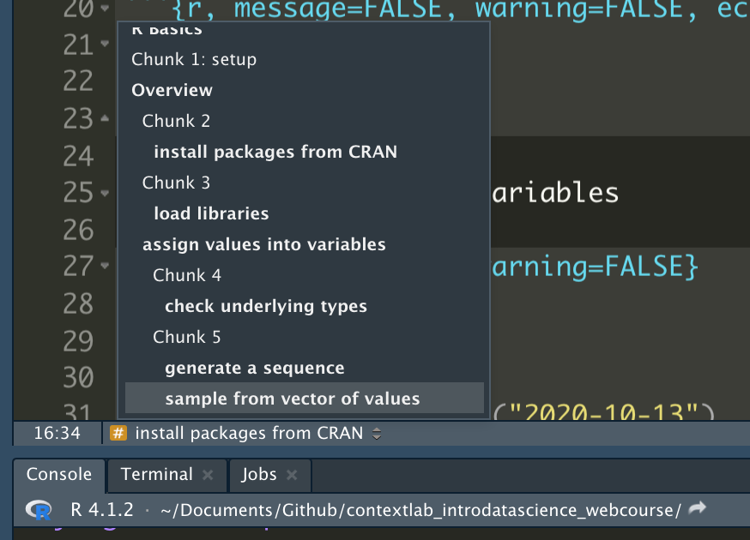
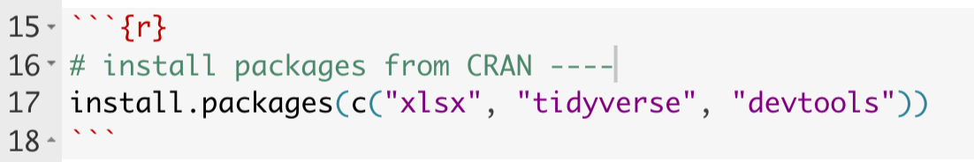
Shortcuts
Command+Enter (Mac) or Ctrl+Enter (Windows) to run the line where your mouse cursor is (or a highlighted selection of code)
Add “-----” inside of a comment to create a shortcut

Slide 44
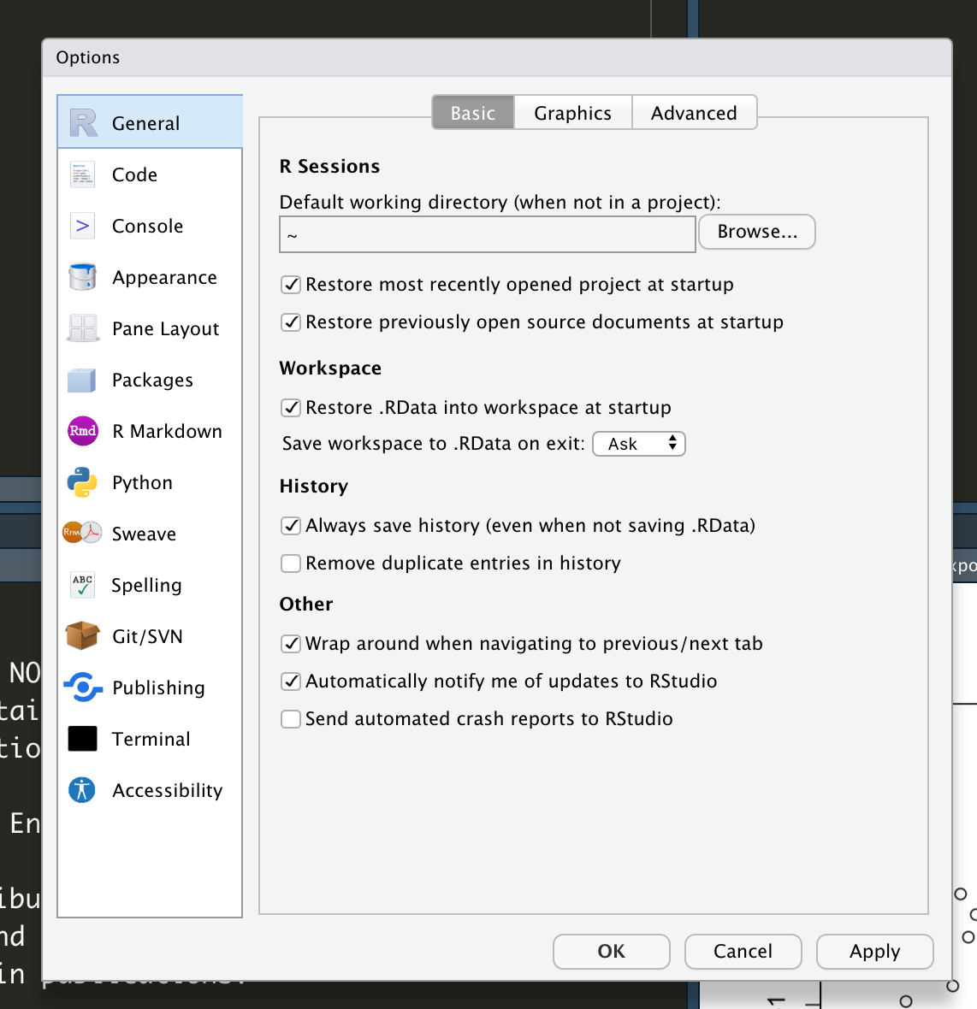
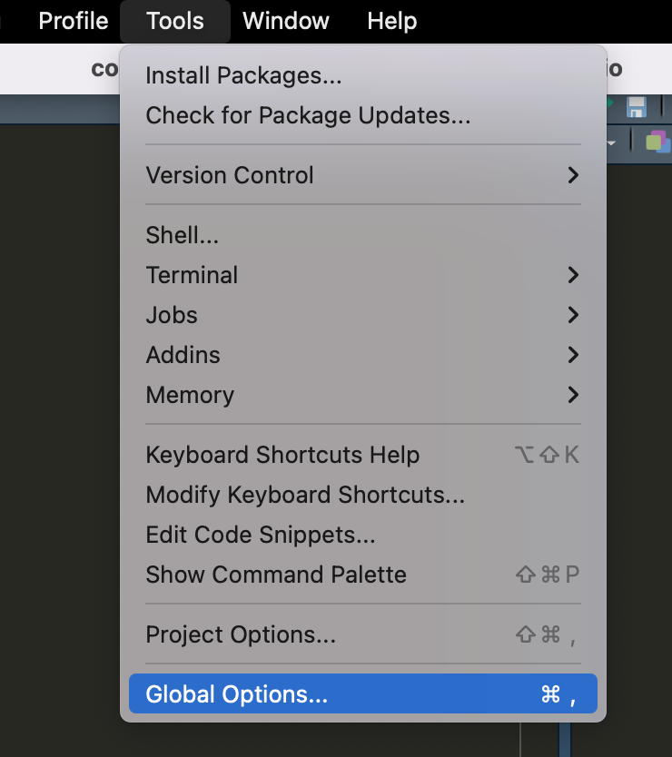
Customizing RStudio

Slide 45
Intro to R Syntax

Slide 46
Basic data types & structures
Character: text data
Numeric: all real numbers with or without decimal values
Integer: real values without decimal points
Logical: TRUE, FALSE
Raw: raw bytes of data
List: named or numbered array of entries
Data frame and tibble: rectangular representation of data
Vector
Matrix
https://www.programiz.com/r/data-types
Notes:
https://www.programiz.com/r/data-types

Slide 47
Pseudocode Exercise
You allowed participants on Qualtrics to enter state of residence as free text entry, resulting in e.g., Alabama, as: ‘AL’, ‘Al’, ‘Alabama’, ‘ALABAMA’.
Ideally you want them all to be two upper case letters.
Goal: in words only (no code), describe your approach to solving the data problem above.

Slide 48
Let’s jump into R
Scan the QR code to view the code we will work with
Notes:
Scipts we will go over
https://github.com/nelsonroque/contextlab_reproduciblescience_workshops/blob/main/scripts/03-r-basics.Rmd
https://github.com/nelsonroque/contextlab_reproduciblescience_workshops/blob/main/scripts/04-r-pipeline.Rmd
https://github.com/nelsonroque/contextlab_reproduciblescience_workshops/blob/main/scripts/05-date-manipulation.Rmd

Slide 49
Data Science: Latest Trends

Slide 50
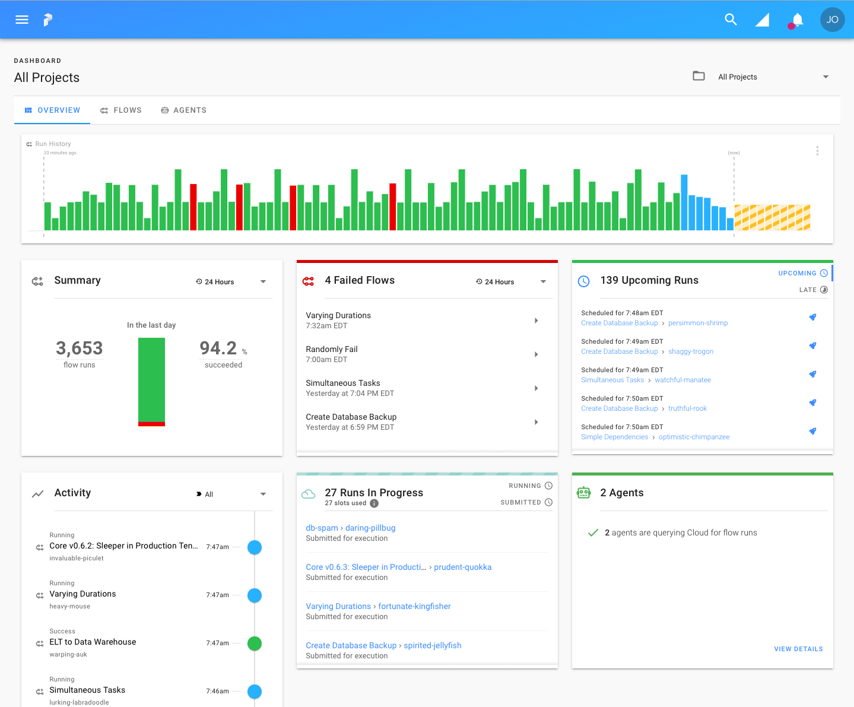
ETL Pipelines
Extract
Programmatically download data from origin (database, file server)
Transform
Manipulate, score, reformat data as needed for computational needs
Load
Re-save transform dataset(s) in new location on origin server (or other server)

Slide 51
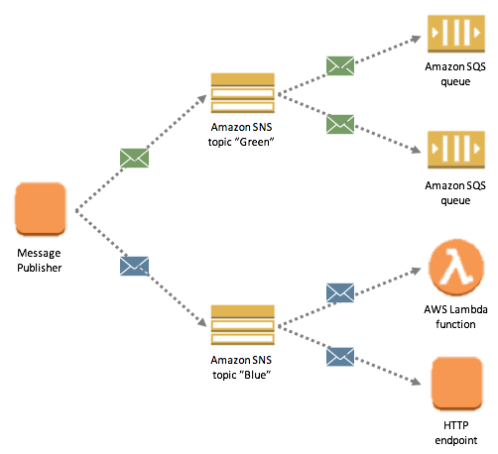
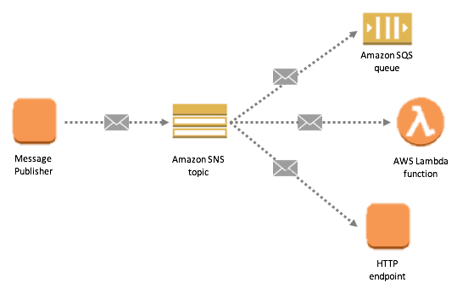
What is PubSub?
Messaging pattern for loosely coupled communication between highly cohesive components
Why PubSub?
Scalable, fault-tolerant, and highly available

Slide 52
How I’ve Used PubSub Messaging
Send a message to a topic for each device in a study, and query all data for last X days from device API
e.g., Fitbit, Air quality devices
Send a message to a topic for each cognitive task, query respective data, score it, and publish to API/store in new database table

Slide 53








Automating data jobs with PubSub
Publish job
Process job
Notify
{
“JOB_TYPE”: “score”, “STUDY_ID”: “TMB”
}
Function score_job()
Job complete!
On schedule
i.e., send message to SNS topic (e.g., JSON format, string)
Upon detecting new message on topic, job processor applies necessary algorithms and sends data to next step
Send job status to SMS, Teams, Slack, etc
Amazon EventBridge
Amazon Lambda
Amazon SNS

Slide 54
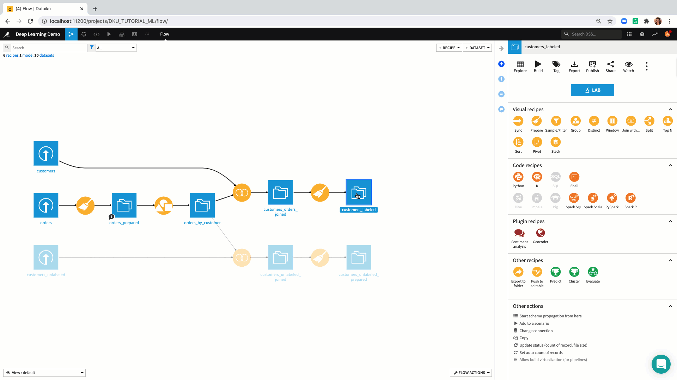

The Future of Data Workflows
Seamless integration platforms, for example:

Slide 55
Long-term learning

Slide 56

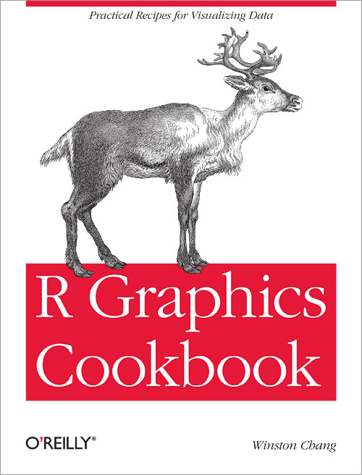
Reading Recommendations
https://r4ds.had.co.nz
https://r-graphics.org

Slide 57
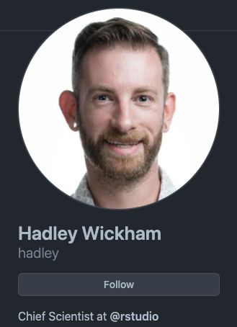
Tutorial Recommendations
Anything by Hadley Wickham
https://www.r-bloggers.com/
https://www.r-statistics.com/
https://blog.revolutionanalytics.com/
https://r-charts.com/
http://www.cookbook-r.com/Graphs/
https://plotly.com/r/

Slide 58
Download Open Data
Kaggle
https://www.kaggle.com/datasets
Data.gov
https://www.data.gov/

Slide 59
Download Cheatsheets
Data Import
https://github.com/rstudio/cheatsheets/raw/master/data-import.pdf)
Data Wrangling Cheatsheet
https://www.rstudio.com/wp-content/uploads/2015/02/data-wrangling-cheatsheet.pdf)
Data Transformation with dplyr
https://github.com/rstudio/cheatsheets/raw/master/data-visualization.pdf)
String Manipulation
https://github.com/rstudio/cheatsheets/raw/master/strings.pdf)
Work with dates/times
https://github.com/rstudio/cheatsheets/raw/master/lubridate.pdf)
R Markdown
https://github.com/rstudio/cheatsheets/raw/master/rmarkdown.pdf)
More cheatsheets
https://www.rstudio.com/resources/cheatsheets/)

Slide 60









nelson.roque@ucf.edu
nelsonroque.com
https://github.com/nelsonroque
thank
you

